Slide 1


3D Graphics
Workshop 7

Slide 2
Animation
Computer animation is about ‘making things move’.
In film, animations are created off-line, possibly taking days of animator time per scene.
in games everything must be done in real time.
In practice, create a number of animations off line,
either animating them by hand or using motion capture,
which are then triggered in real time based on game events.
Animation can also be created procedurally using a physics engine or a particle system.

Slide 3

Traditional Animation
Flipbook
Presents a sequence of images in quick succession, each of which is a page of the book.
Each image changes slightly from the previous one.
If flip through the pages fast enough the images are presented one by one and the small changes no longer seem like a sequence of individual images but a continuous sequence.
In film, this becomes a sequence of frames, which are also images, but they are shown automatically on a file projector.

Slide 4
Traditional Animation
Cel animation
A sequence of images is displayed at 25 frames per second (the minimum to make it appear like smooth motion).
For the purpose of creating animation these images are arranged in a ‘time line’.
In traditional animation this is a set of images with frame numbers drawn by the side.
Each frame is an image.
Traditionally each image had to be hand drawn individually.
This potentially required vast amounts of work from a highly skilled animator.
What is more, in order to make the final animation look consistent each character should always be drawn by the same animator.

Slide 5




Traditional Animation
Hayao Miyazaki (宮崎 駿)
Studio Ghibli
Master of Cel Animation
Have produced many famous Anime
Insisted on hand-drawn over computer animation

Slide 6
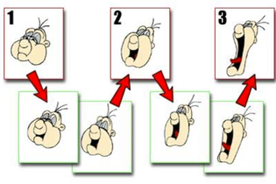
Traditional Animation
Keyframing
Only need a few images to get the entire feel of a sequence of animation,
but need many more to make the final animation look smooth.
The head animator for a particular character draws the most important frames (keyframes).
An assistant draws the in-between frames (inbetweening).

Slide 7
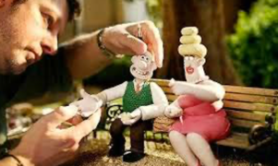
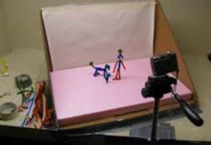
Traditional Animation
Stop motion
Taking many still photographs of real objects instead of drawing images.
The object is moved very slightly after each photograph to get the appearances of movement.
More work is put into creating characters.
Can have characters with a lot of detail and character creators will spend a lot of effort making characters easy to move.

Slide 8
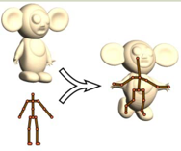
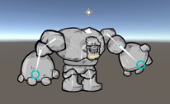
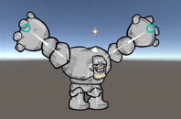
COMPUTER ANIMATION
Similar to Stop Motion Animation.
Create a (virtual) model of a character ¡ Then move it frame by frame for animation.
Rigging
easy-to-use controls for a character
Human characters will have complex skeletons,
Once you have completed this set up effectively, animation becomes much simpler.

Slide 9
KEYFRAMING
The animator only needs to define the ‘key frames’ of a movement (which will be values for transforms).
The computer does the inbetweening automatically. ¡ Keyframes are a tuple consisting of the time at which the
keyframe occurs and the value of the transforms.
These will be set up in a timeline, which is just an array of keyframes

Slide 10
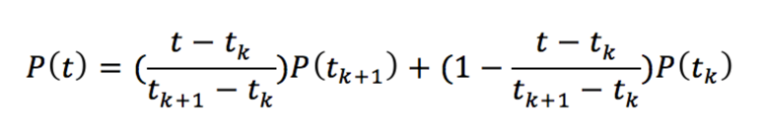
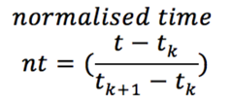
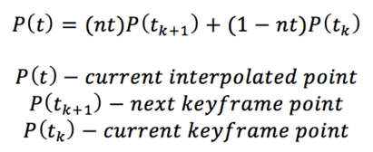
LINEAR INTERPOLATION
The simplest approach is to interpolate them in straight lines between the keyframes
The position is interpolated linearly between keyframes using the following equation:

Slide 11
LINEAR INTERPOLATION
Example
Assume we have the following 3 frames (0, 1 and 2)
We want to linear interpolate from frame 0 to 1 and 1 to 2
From frame 0 to 1 is from point (0,0) time 0 to before point (20,30) time 10
From frame 1 to 2 is from point (20,30) time 10 to before point (40,50) time 20
Frame | Point x | Point y | Time
0 | 0 | 0 | 0
1 | 20 | 30 | 10
2 | 40 | 50 | 20

Slide 12
LINEAR INTERPOLATION
From frame 0 to 1 is from point (0,0) time 0 to before point (20,30) time 10
From Frame 0 to 1 (0,0) to (20,30) Time 0 to 9
Time | Normalised Time | Point x | Point y
0 | 0 | 0 | 0
1 | 0.1 | 2 | 3
2 | 0.2 | 4 | 6
3 | 0.3 | 6 | 9
4 | 0.4 | 7 | 12
5 | 0.5 | 10 | 15
6 | 0.6 | 12 | 18
7 | 0.7 | 14 | 21
8 | 0.8 | 16 | 24
9 | 0.9 | 18 | 27
Example at current time 3
Normalised time = (3-0)/(10-0)
= 0.3
Interpolated point at current time 3
Point x = 0.3*20 + (1-0.3)*0
= 6
Point y = 0.3*30 + (1-0.3)*0
= 9

Slide 13
LINEAR INTERPOLATION
From frame 1 to 2 is from point (20,30) time 10 to before point (40,50) time 20
From Frame 1 to 2 (20,30) to (40,50) Time 10 to 19
Time | Normalised Time | Point x | Point y
10 | 0 | 20 | 30
11 | 0.1 | 22 | 32
12 | 0.2 | 24 | 34
13 | 0.3 | 26 | 36
14 | 0.4 | 28 | 38
15 | 0.5 | 30 | 40
16 | 0.6 | 32 | 42
17 | 0.7 | 34 | 44
18 | 0.8 | 36 | 46
19 | 0.9 | 38 | 48
Example at current time 12 Normalised time = (12-10)/(20-10)
= 0.2 Interpolated point at current time 12
Point x = 0.2*40+ (1-0.2)*20
= 24
Point y = 0.2*50 + (1-0.2)*30
= 34

Slide 14
LINEAR INTERPOLATION
Implementing in Unity3D
Complete Workshop 7 Lab 1 to have an idea of implementing of linear interpolation.

Slide 15
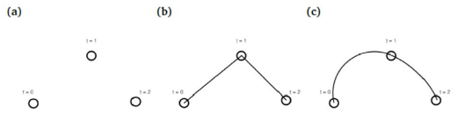
INTERPOLATION
Linear interpolation can be used to implement keyframes, but the animation is not at all smooth.
The object instantly jumps from one keyframe position to the next, rather than gradually moving between the keyframes.
The frames between the keyframes have to be filled in (interpolated).
For example, if you have the following positions of the ball.
(a) Three Keyframes, (b) Linear interpolation (c) Spline interpolation

Slide 16
Keyframes in Unity 3D
Complete Workshop 7 Lab 2 to implement Keyframes animation using Unity3D Animation and Animation Controller.

Slide 17
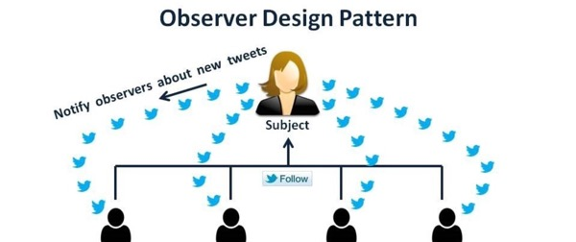
Observer pattern
Observer pattern
a software design pattern
an object, named the subject, maintains a list of its dependents, called observers, and
notifies them automatically of any state changes, usually by calling one of their methods.

Slide 18
Observer pattern in a simple game
Player
EventManager
If the player get shot, notified the observer
Observers
PlayerLife
PlayerSounds
EnemyActions
GameState
For the observer to get notified, each of them must subscribe to the EventManager.

Slide 19
Unity C# Events
Complete Workshop 7 Lab 3 to learn how to implement the observer pattern using C# Events.

Slide 20
Unity Event
Complete Workshop 7 Lab 4 to learn how to implement the observer pattern using Unity Events.

